Slide 1



Cooperative estimation for feature-based SLAM
Tim Woodbury, Neha Satak, Kevin Brink
July 31, 2014
/

Slide 2
Outline
Introduction
Problem background
Simulation results
Summary and future work

Slide 3
Introduction
Multi-vehicle scenarios
Academic problems
Cooperative control
Coalition tasking/planning
Mapping
Examples
Search and rescue
Geological survey
Firefighting

Slide 4
Cooperative estimation
Challenges
GPS-denied/indoor operation
Sensor accuracy
Comm bandwidth/loss
What data to share?
Approach
Simultaneous localization and mapping (SLAM)
Agent-agent position sensing
Shared feature measurements
Decentralized filter
Notes:
Other approaches: centralized filter, shared interagent esimates

Slide 5
Pathfinder project
Interest in project
Cooperative/multi-agent hardware problems
Game theory
Estimation
Planning
Mapping
Collaboration
High-level decision-making
Low-level sensors
My contribution
Optitrack/PX4 data fusion and processing
Parameter identification (drag, sensor variance)

Slide 6
Problem definition
Two agents, planar
M features, known
Interagent range & bearing
Two cases
Feature range and bearing
Feature bearing only
m_{j}
m_{i}
j
i

Slide 7

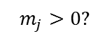
Information flow
Agent i
Agent j
Feature measurements
Interagent measurements
Feature measurements
Interagent measurements
$$m_{i}>0?$$
EKF (i)
$$m_{j}>0?$$
EKF (j)

Slide 8
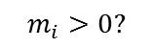
Information flow
Agent i
Agent j
Feature measurements
Interagent measurements
Feature measurements
Interagent measurements
$$m_{i}>0?$$
EKF (i)
$$m_{j}>0?$$
EKF (j)

Slide 9
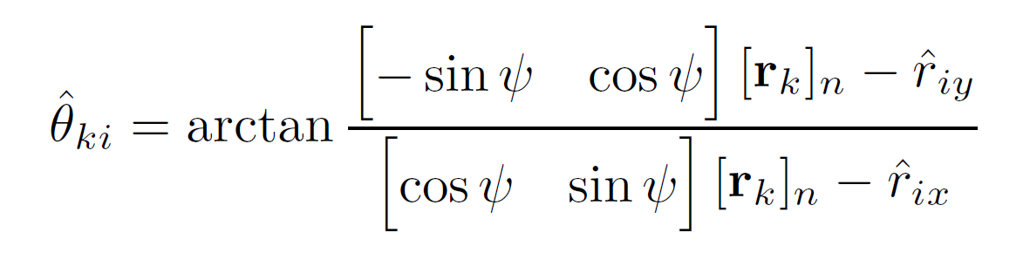
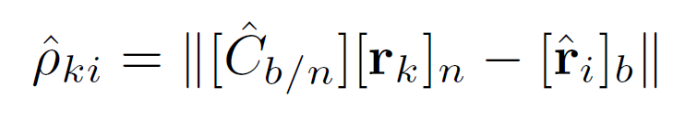
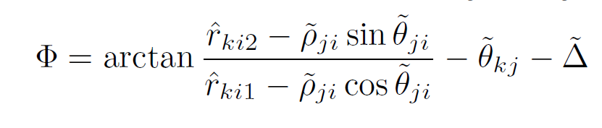
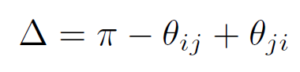
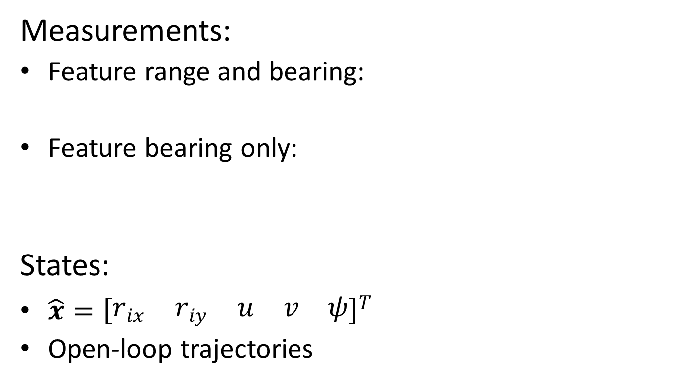
State and measurement model
Measurements:
Feature range and bearing:
Feature bearing only:
States:
$\hat{x}={\left[\begin{matrix}r_{ix} & r_{iy} & u & v & ψ\end{matrix}\right]}^{T}$
Open-loop trajectories

Slide 10
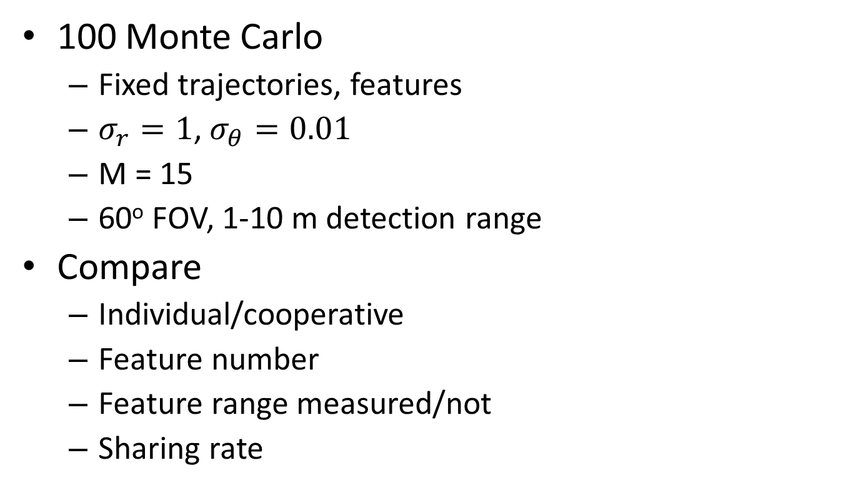
Simulation parameters
100 Monte Carlo
Fixed trajectories, features
$σ_{r}=1$,$σ_{θ}=0.01$
M = 15
60º FOV, 1-10 m detection range
Compare
Individual/cooperative
Feature number
Feature range measured/not
Sharing rate

Slide 11
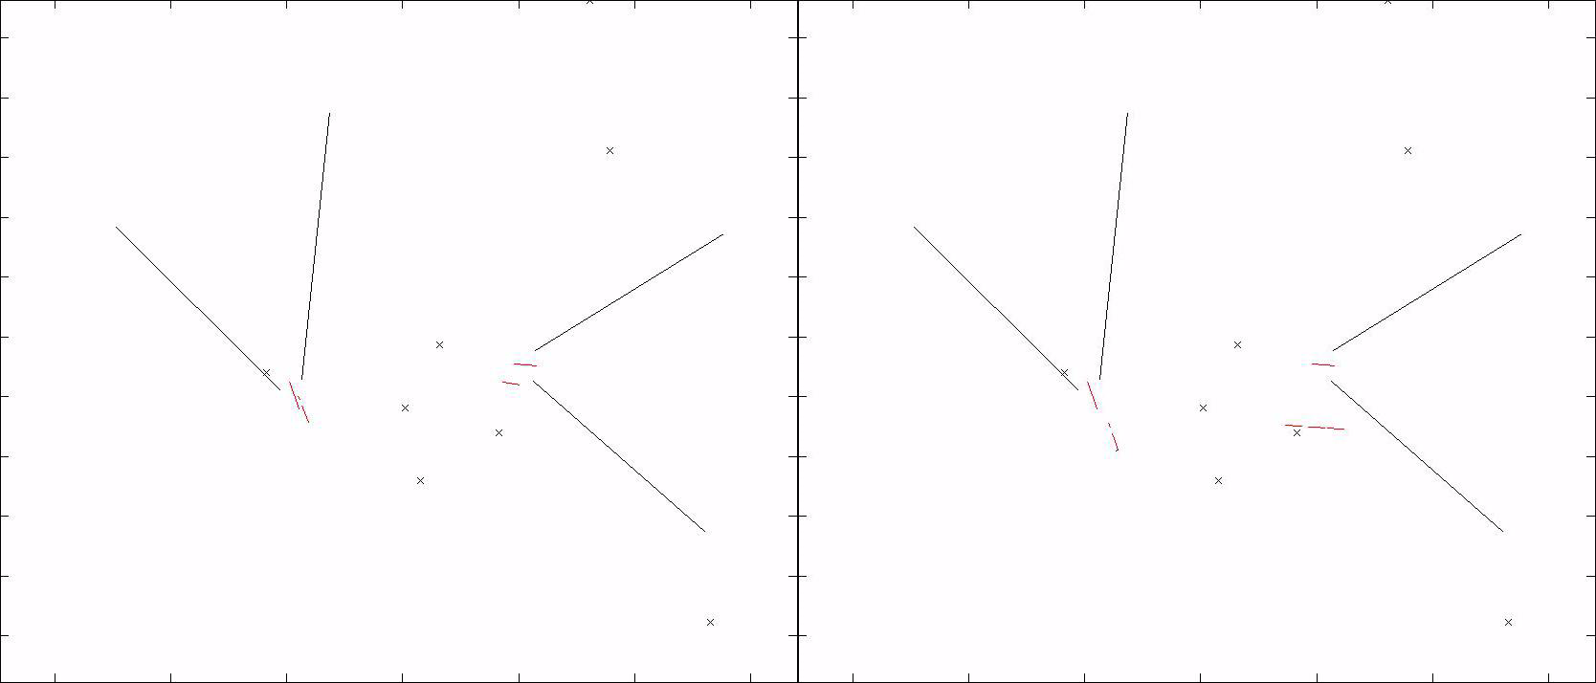
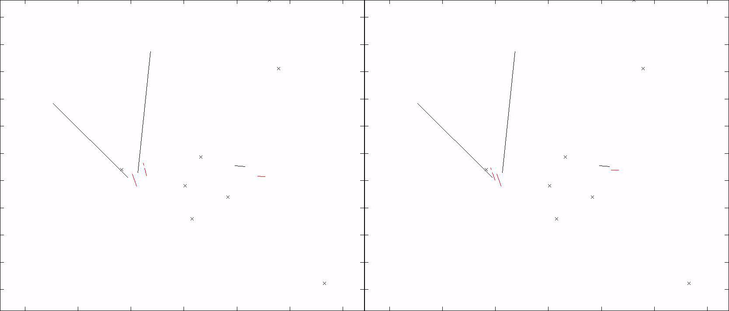
Animation #1
Individual
Cooperative

Slide 12
Animation #2
Individual
Cooperative

Slide 13
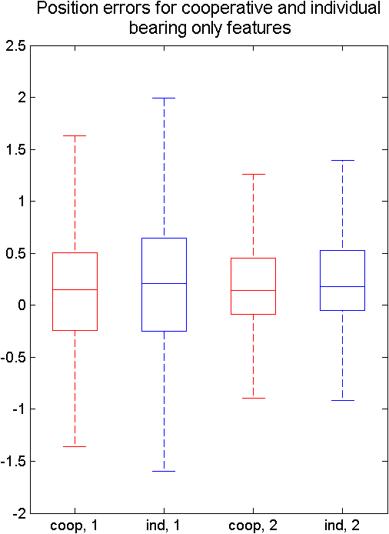
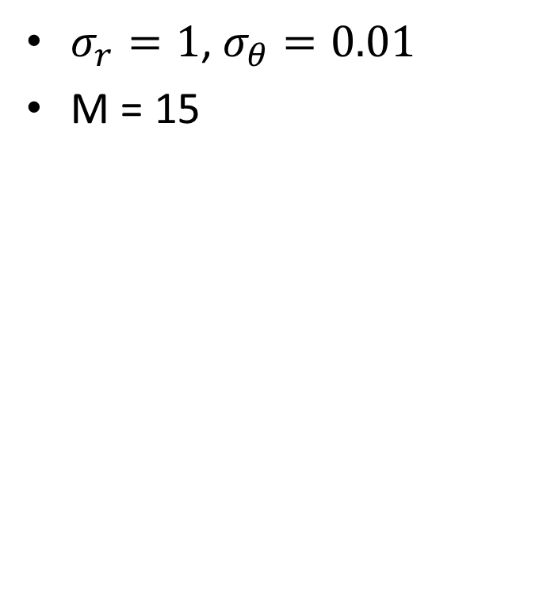
Sharing vs. Individual
$σ_{r}=1$,$σ_{θ}=0.01$
M = 15
Case | S(ε_{X}) | S(ε_{Y})
Individual, 1 | 1.63 | 1.37
Coop, 1 | 0.98 | 0.654
Individual, 2 | 0.975 | 0.684
Coop, 2 | 0.713 | 0.668
Notes:
Box-whisker: red is median, boxes are 25th and 75th percentiles, whiskers are ``outlier’’ boundary. ~~ +/- 2.7sigma if normally distr

Slide 14
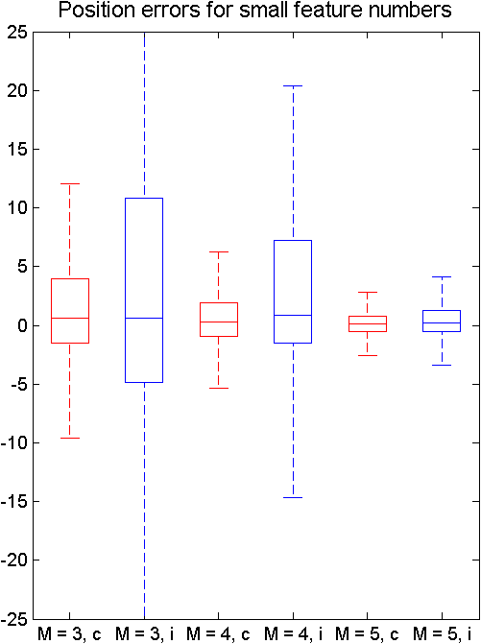
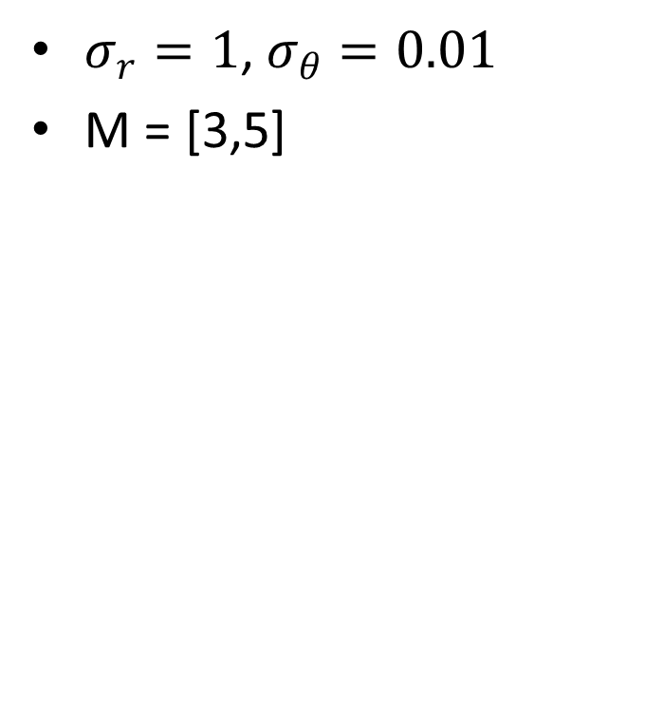
Sparse features
$σ_{r}=1$,$σ_{θ}=0.01$
M = [3,5]
Case | S(ε_{X}) | S(ε_{Y})
M = 5, coop | 1.67 | 1.33
M = 4, coop | 7.2 | 7.87
M = 5, ind | 3.54 | 3.29
M = 4, ind | 27.5 | 27.2

Slide 15
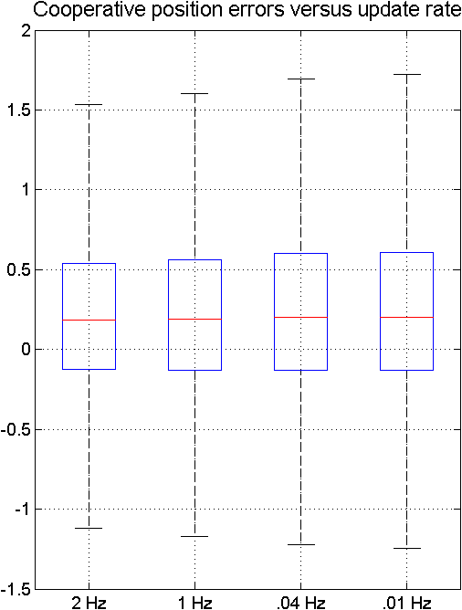
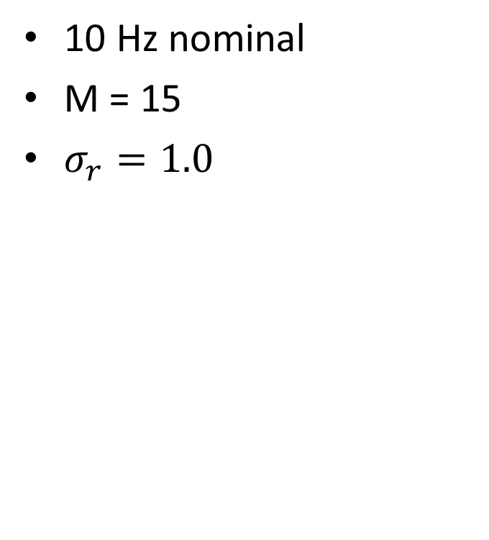
Sharing rate
10 Hz nominal
M = 15
$σ_{r}=1.0$
Case | S(ε_{X}) | S(ε_{Y})
2 Hz | 1.08 | 0.801
1 Hz | 1.24 | 0.943
0.04 Hz | 1.26 | 0.959
0.01 Hz | 1.36 | 1.07

Slide 16
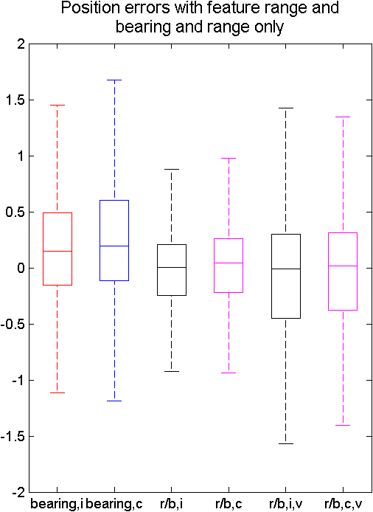
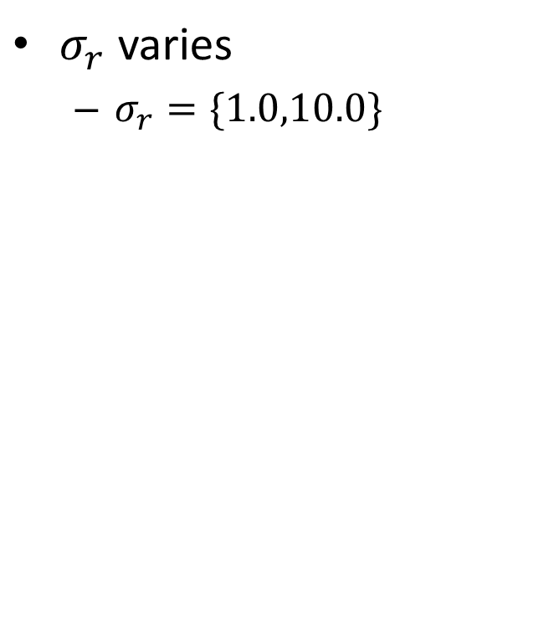
Feature range effect
$σ_{r}$ varies
$σ_{r}=\{1.0,10.0\}$
Case | S(ε_{X}) | S(ε_{Y})
B, ind | 1.63 | 1.37
B, coop | 0.98 | 0.654
R/b, σ = 1 | 0.749 | 0.649
R/b, σ = 10 | 1.33 | 0.973

Slide 17
Conclusions
Improved estimation accuracy for cooperative
More robustness to few features
Sharing effective at ≈10% nominal rate
Bearing-only vs. range/bearing

Slide 18
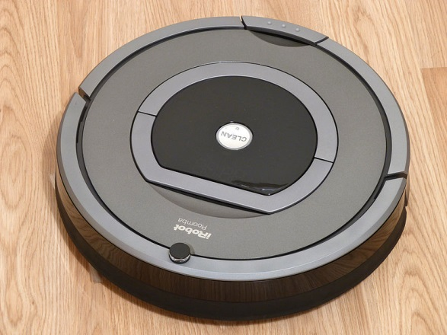
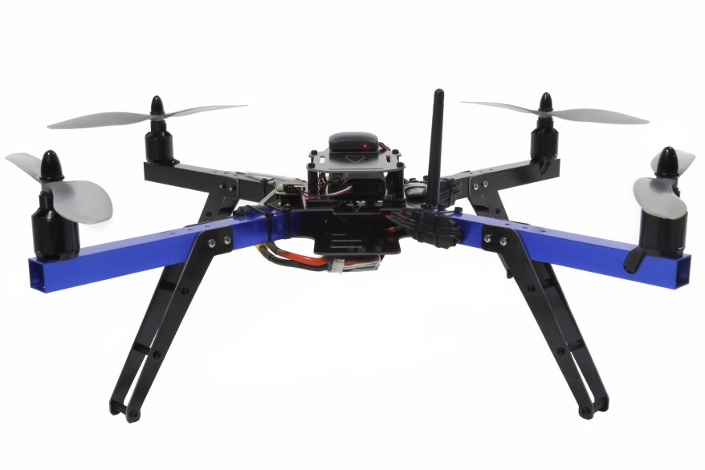
Future work
Extensions
Higher dimensions
Hardware experiments
Planning/tasking
Cooperative search
http://commons.wikimedia.org/wiki/File:IRobot_Roomba_780.jpg
https://store.3drobotics.com/products/apm-3dr-quad-rtf

Slide 19
Questions

Slide 20
Backup

Slide 21
References
Gyorgy, K., Kelemen, A., and David, L., “Unscented Kalman Filters and Particle Filter methods for nonlinear state estimation," in International Conference in Engineering Interdisciplinarity, 2014
Crassidis, J.L. and Junkins, J.L., Optimal Estimation of Dynamic Systems, 2nd ed., CRC Press, 2011

Slide 22
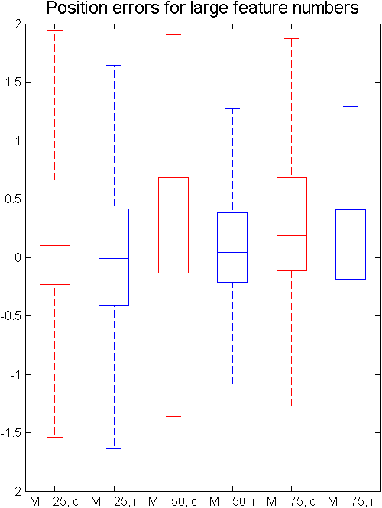
Dense features
1000 Monte Carlo
Initial condition errors
Case | S(ε_{X}) | S(ε_{Y})
M = 25, coop | 0.638 | 0.496
M = 50, coop | 0.316 | 0.292
M = 75, coop | 0.269 | 0.207
M = 25, ind | 0.669 | 0.509
M = 50, ind | 0.412 | 0.305
M = 75, ind | 0.276 | 0.167

Slide 23
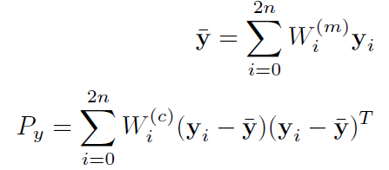
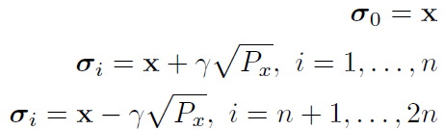
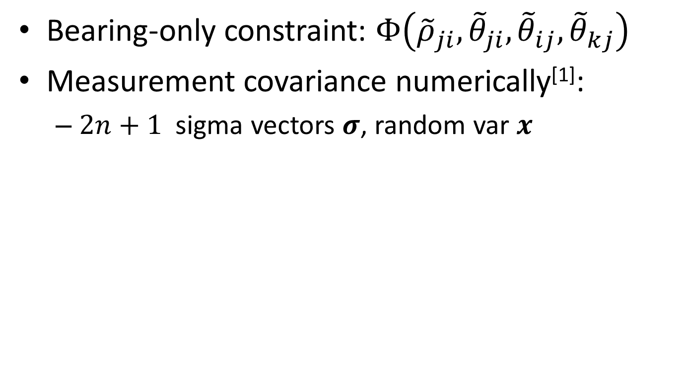
Statistical linearization
Bearing-only constraint: $Φ\left({\tilde{ρ}}_{ji},{\tilde{θ}}_{ji},{\tilde{θ}}_{ij},{\tilde{θ}}_{kj}\right)$
Measurement covariance numerically^{[1]}:
$2n+1$ sigma vectors $σ$, random var $x$

Slide 24
Presentation outline
Introduction
SLAM
Cooperative estimation
Problem background
Problem definition
Vehicle and sensor modeling
EKF
Simulation
Simulation parameters
Results (tables)
Animation
Summary and future work
Conclusions
Future directions
Hardware experiments
Coalitions/cooperative tasking

Slide 25
PX4 System Overview
Sensors
GCS commands
Estimators
Pilot-in-command
Mode logic
Waypoint controller
Velocity controller
Attitude controller
Motors

Slide 26
PX4 System Overview
Motion capture
Sensors
Parameter identification
GCS commands
Estimators
Onboard SBC
New estimator
Pilot-in-command
Mode logic
Waypoint controller
Velocity controller
Attitude controller
New velocity controller
Motors

Slide 27
PX4 System Overview (baseline)
placeholder
Motion capture
Sensors
Parameter identification
GCS commands
Estimators
Onboard SBC
New estimator
Pilot-in-command
Mode logic
Waypoint controller
Velocity controller
Attitude controller
New velocity controller
Motors

Slide 28
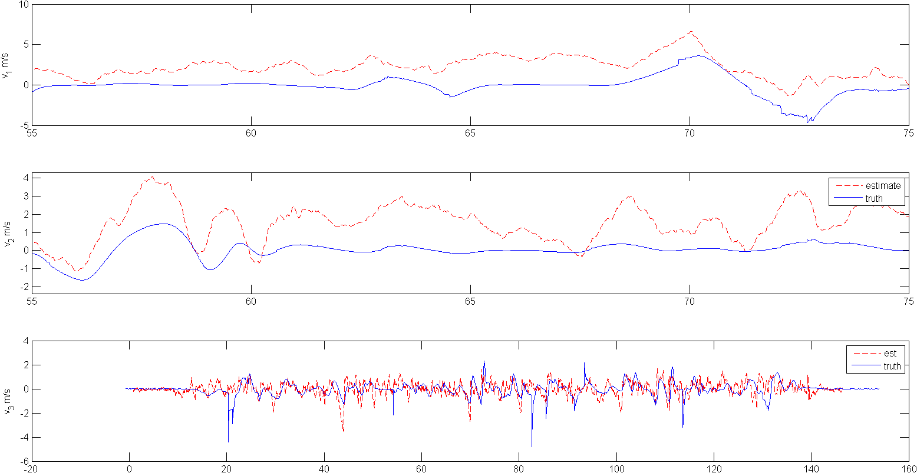
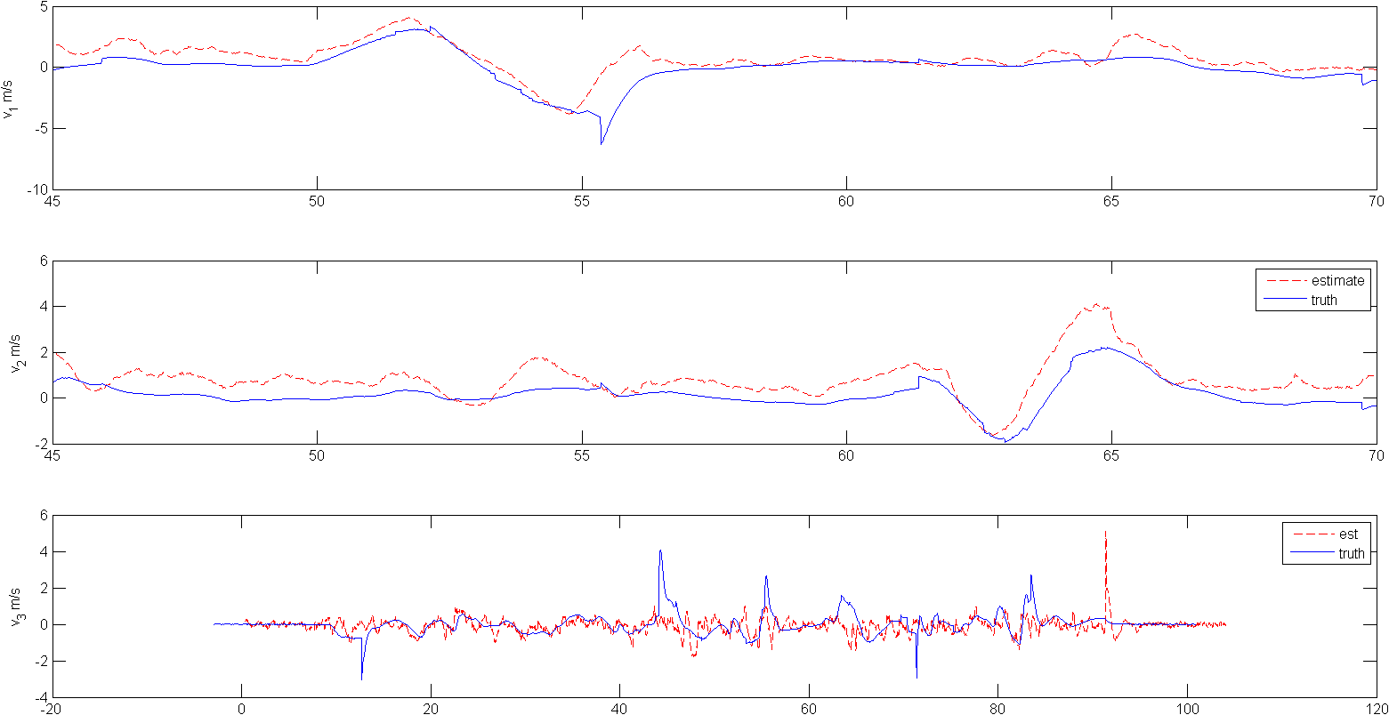
Motion capture
Analysis tools
Sensor characterization
Optic flow
Sonar
IMU
Drag coefficient
Above: early drag coefficient. Below: current
μ | S(v_{x}) (m/s) | S(v_{y}) (m/s)
Initial | 1.47 | 1.11
Current | 0.593 | 0.641

Slide 29
Velocity controller
Two? controllers
PID
Model inversion
Some kind of simulation result

